Slide 1



Report
View in Power BI
Last data refresh:
3/25/2023 9:47:19 PM UTC
Downloaded at:
4/3/2023 8:33:53 AM UTC

Slide 2
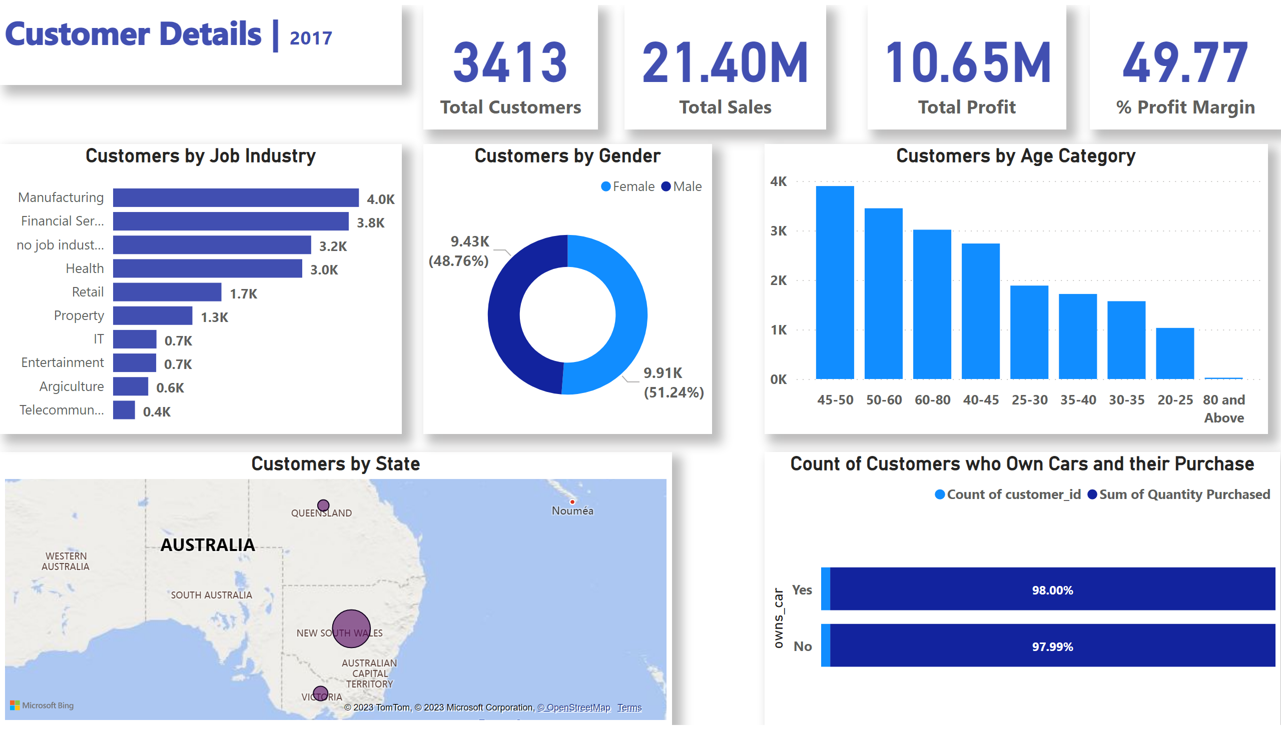
Customer Analysis
Notes:
Customers by State
No alt text provided
textbox
No alt text provided
card
No alt text provided
card
No alt text provided
card
No alt text provided
Customers by Job Industry
No alt text provided
Customers by Gender
No alt text provided
Customers by Age Category
No alt text provided
Count of Customers who Own Cars and their Purchase
No alt text provided
card
No alt text provided

Slide 3
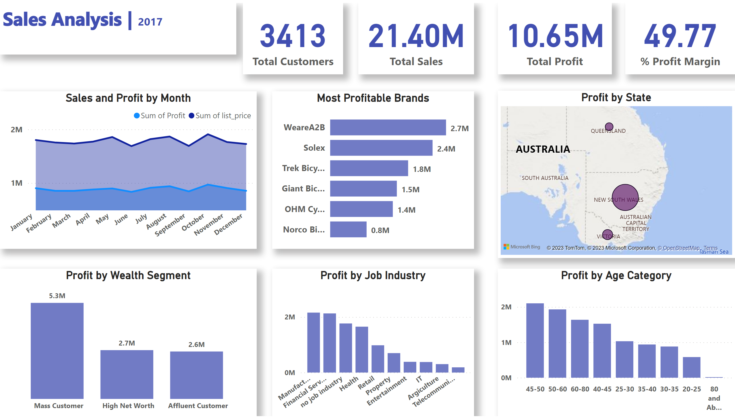
Profit Analysis
Notes:
Profit by Age Category
No alt text provided
textbox
No alt text provided
card
No alt text provided
card
No alt text provided
card
No alt text provided
card
No alt text provided
Profit by State
No alt text provided
Most Profitable Brands
No alt text provided
Profit by Wealth Segment
No alt text provided
Sales and Profit by Month
No alt text provided
Profit by Job Industry
No alt text provided

Slide 4
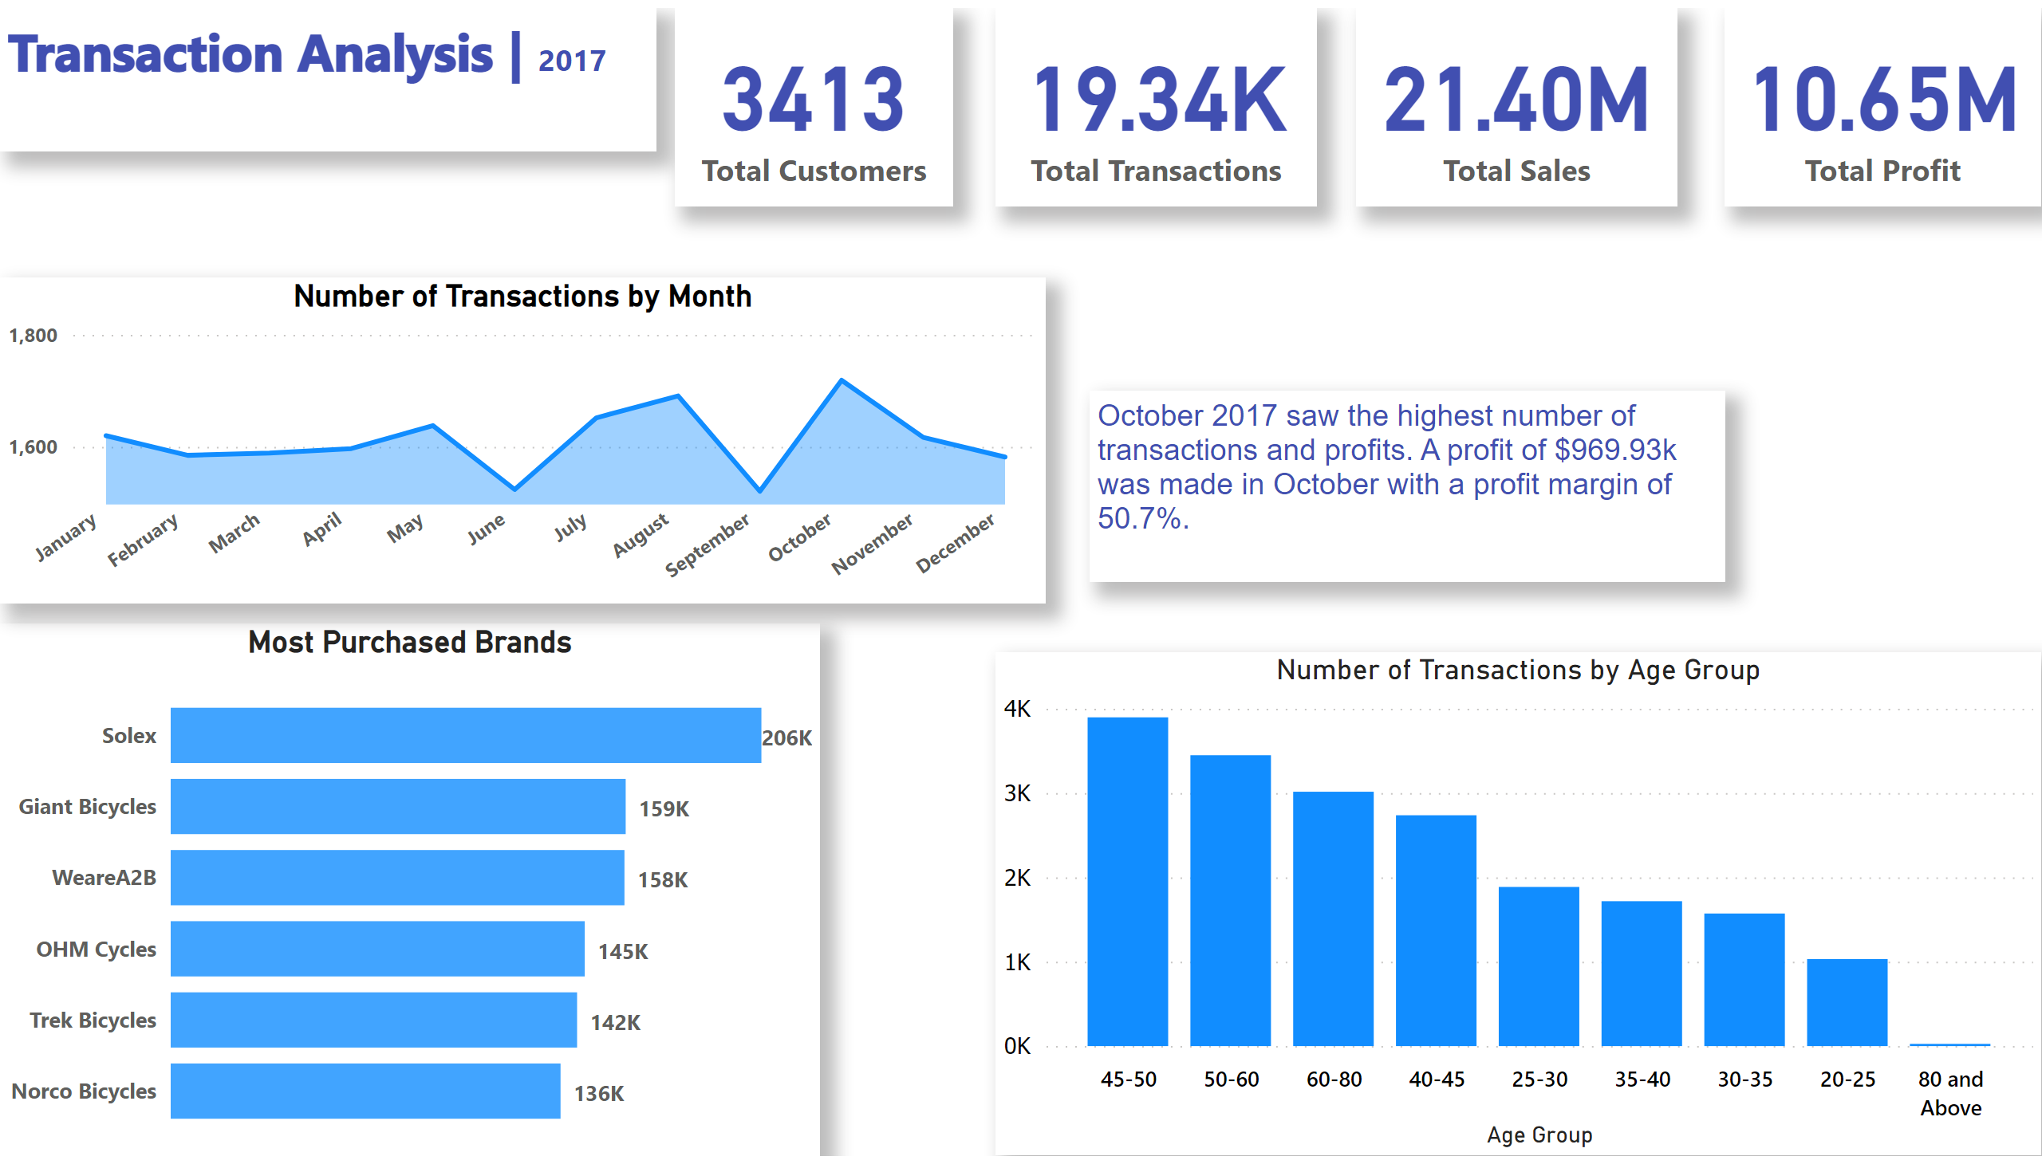
Transactions Analysis
Notes:
Number of Transactions
No alt text provided
Number of Transactions by Month
No alt text provided
textbox
No alt text provided
textbox
No alt text provided
card
No alt text provided
card
No alt text provided
card
No alt text provided
Most Purchased Brands
No alt text provided
Number of Transactions by Age Group
No alt text provided

Slide 5
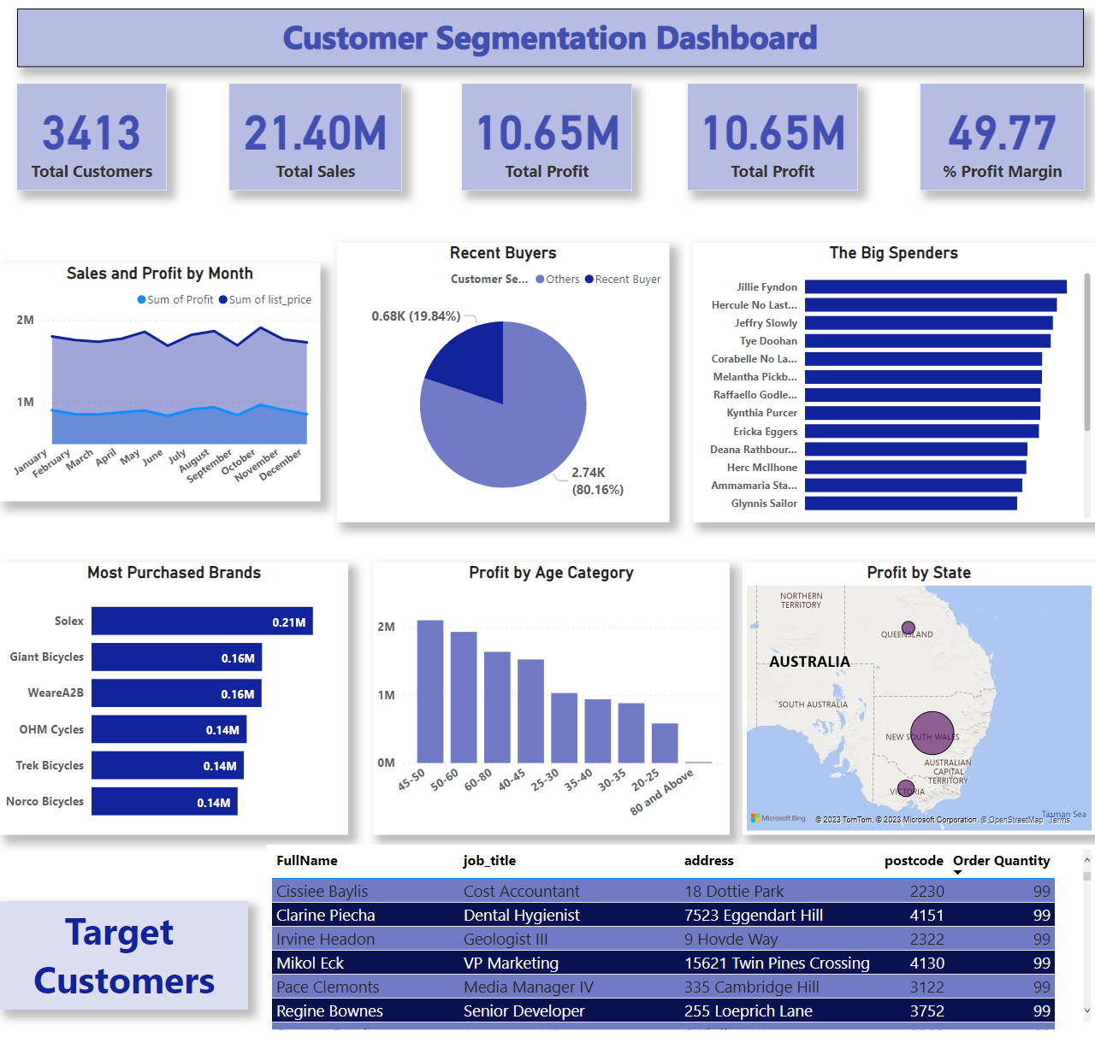
Dashboard
Notes:
textbox
No alt text provided
card
No alt text provided
card
No alt text provided
card
No alt text provided
card
No alt text provided
card
No alt text provided
The Big Spenders
No alt text provided
Recent Buyers
No alt text provided
Sales and Profit by Month
No alt text provided
Most Purchased Brands
No alt text provided
Profit by Age Category
No alt text provided
Profit by State
No alt text provided
textbox
No alt text provided
Target Customers
No alt text provided

